Slide 1
What is the Inquiry Method?
Part of the
Professional Development Workshop on Inquiry

Slide 2


Introduction Videos
What is inquiry
What are the benefits of inquiry?

Slide 3
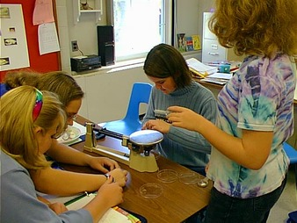
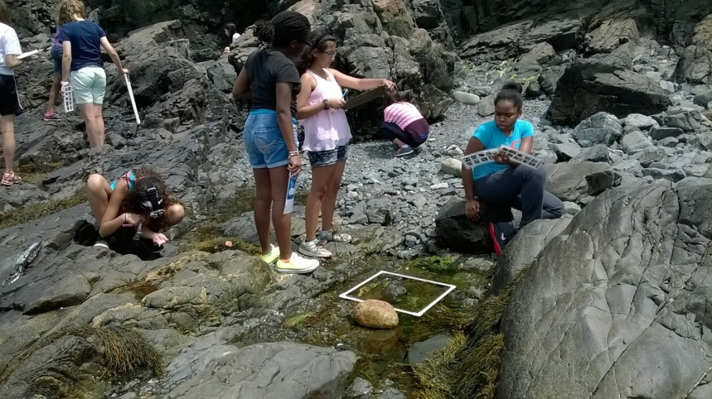
What is Inquiry?
Colburn (2000) : “The creation of a classroom where students are engaged in essentially open ended, student centered, hands on activities.”
Bell et al. (2005): “The inquiry method is a active learning process in which students answer research questions through data analysis.”
Savery (2006) :“A student centered learning approach that focuses on questions, critical thinking, and problem solving.”
What all the definitions seem to agree on is that the students are engaged with the content, they are working with questions and data to understand and explore concepts.

Slide 4
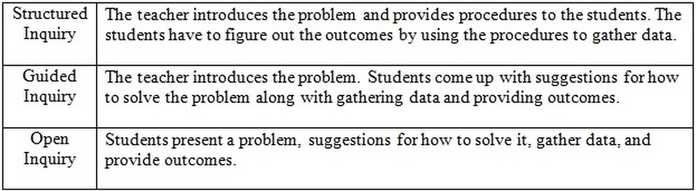
What are the Levels of Inquiry?
Structured
Guided
Open

Slide 5
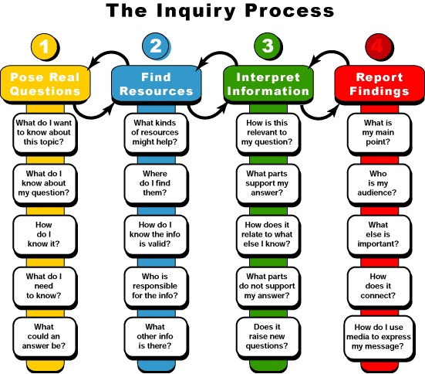
What are the Steps of the Inquiry Method?
1. Ask a question or be presented a problem 2. Contemplate possible solutions or ways to investigate the problem 3. Investigate the solutions 4. Formulate new knowledge as investigating solutions 5. Reflect of new knowledge and how it applies to initial problem or question 6. Discuss discoveries and solutions to problem/question A way to make sure that the lesson is inquiry based is that verify that the question can be researched and that students are analyzing data relevant to the question/problem (Bell et al. 2005).

Slide 6

What are the Benefits of the Inquiry Method?
Increases content knowledge
Increases retention rate
Motivate and engage students
What else what mentioned in the movie?

